Slide 1
Linear Regression

Slide 2
Simple Linear Regression
Consider the following three scenarios:
The CEO of the local Tourism Authority would like to know whether a family’s annual expenditure on recreation is related to their annual income. This information could be used to tailor marketing campaigns to certain consumer segments.
A food company is interested in determining a shelf-life for a new chilled food product and hence they would like to quantify the relationship between microbial activity and time.
A car buyer is interested in purchasing a second hand car and would like to ascertain the relationship between a car’s age and advertised purchase price.

Slide 3
Simple Linear Regression
What do these three scenarios have in common?
The answer is that they all involve the quantification of the relationship between two variables.
Deterministic Relation and statistical relationship
This relationship is of interest as it allows us
To gain an understanding of the problem
To make predictions
To assess new data in light of the relationship
Applications:
Business
Genetics
Food Science, etc

Slide 4
Simple Linear Regression
Data:
Suppose you are a consultant to the local Tourism Authority and the CEO of the Authority would like to know whether a family’s annual expenditure on recreation is related to their annual income.
In addition, if there is a relationship, he would like you to build a statistical model which quantifies the relationship between the two variables
A data set consisting of a random sample of 20 families, collected last year is available to help you with the assessment.
two quantitative variables → family’s annual expenditure on recreation and annual income
Dependent Variable (Y) → Expenditure
Independent Variable (X) → Income

Slide 5
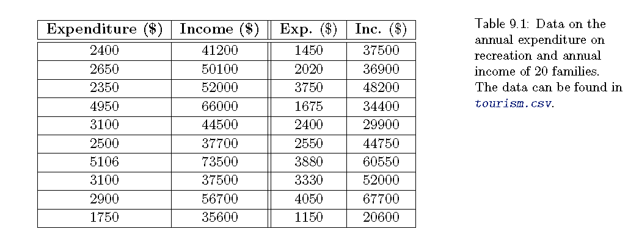
Simple Linear Regression

Slide 6
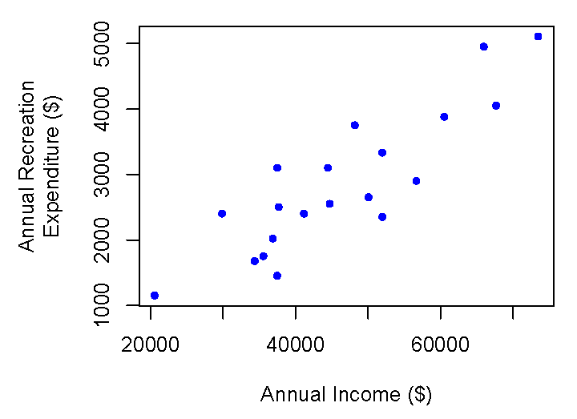
Simple Linear Regression
Graphical Summary of Data: Scatter plot → relation between two variables
Dependent Variable (Y) → vertical axis
Independent Variable (X) → Horizontal Axis
A scatter plot is frequently also referred to as a plot of Y versus X.
Relation between income and expenditure:
Direction: Positive → as income increases so does recreation expenditure;
Shape: Roughly linear → the points appear to fall along a straight line
Strength: Reasonably strong → there is considerable scatter about a straight line.

Slide 7
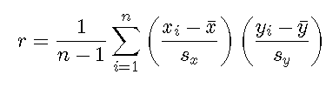
Simple Linear Regression
Numerical summary of the data — Correlation:
A numerical summary of the strength of the association between the two variables is often desired. → population correlation coefficient, ρ. → it measures which measures the strength of the linear association between two variables X and Y.
Since X and Y are quantitative variables, ρ is also known as Pearson correlation coefficient.
The sample correlation coefficient r can be as follows
ẋ and ẏ are sample means and s_{x} and s_{y} are standard deviations

Slide 8
Simple Linear Regression
Numerical summary of the data — Correlation:
The ρ can take values between −1 and 1 and the interpretation of ρ is as follows
A negative value indicates a decreasing relationship between X and Y , that is, as X increases, Y decreases.
A positive value indicates an increasing relationship between X and Y , that is, as X increases, so does Y .\
A value of 0 indicates that there is no linear relationship between the two variables — this however does not imply that there is no relationship.
The correlation does not give an indication about the value of the slope of any linear relationship.
Whole population can not be measured → only few samples can be measured.

Slide 9

Simple Linear Regression
The Simple Linear Regression Model:
“What is the equation of the linear relationship between the explanatory and response variables?”
Quantifying the relationship will allow us to
better understand the functional relationship between X and Y → how quickly does Y increase for every unit increase in X
make predictions about Y for a new value of X.
The linear regression has the form:
Where Y denotes the dependent variable
X denotes the independent variable;
β₀ denotes the y-intercept;
β₁ denotes the slope of the line; and
E denotes a random error.

Slide 10
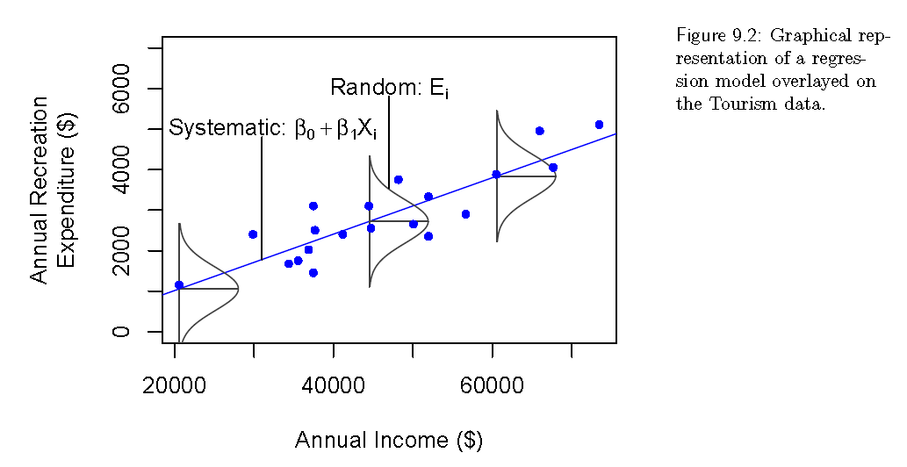
Simple Linear Regression

Slide 11

Simple Linear Regression
Any straight line fitted to the data will take the form y = b₀ + b₁ x
where b₀ and b₁ denote the intercept and the slope of the fitted line.
How good this line fits the data is determined by how close the data points (x_{i}, y_{i}) are to the corresponding points on the line, which are given by
for a given value x_{i}, the observed value of the dependent variable is y_{i} and the corresponding prediction from the line is ˆyi
The residual is calculated as the difference between the two is
If the residual is negative then the observed value lies below the prediction
If the residual is positive then the observed value lies above the prediction.
The residuals need to be combined in some way to give an overall measure of how well the particular line fits the data
positive and negative residuals need add to the lack of fit.

Slide 12


Simple Linear Regression
A commonly used measure of lack-of-fit is the Residual Sum of Squares, RSS, which is also known as Sum of Squared Errors
The best line will result in the smallest RSS from all possible candidate lines b₀ + b₁x.
This smallest RSS indicates that the correspondence between the data and the fitted line is as good as it can possibly be. → this line is called least squares regression (LSR) line and the estimates of the intercept and slope obtained from the LSR line are denoted by and .
The RSS is

Slide 13
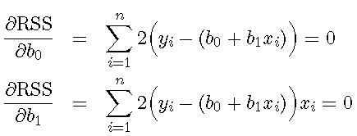
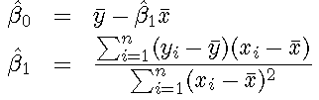
Simple Linear Regression
The aim is to find values for b₀ and b₁ such that RSS is minimized. → In order to do this, the partial derivative of RSS with respect to each b₀ and b₁ are taken and equated to zero.
The solution to these equations yields the least squares regression estimates
where ¯y and ¯x denote the mean of y and x.

Slide 14
Linear Regression
Linear Regression model for the purpose of prediction.
A form of statistical modeling that attempts to evaluate the relationship between one variable (termed the dependent variable) and one or more other variables (termed the independent variables).
It is a form of global analysis as it only produces a single equation for the relationship.
A model for predicting one variable from another.

Slide 15
Linear Regression
Example in Class

Slide 16
Thank you

